Slide 1
STM32 – LCD
Federica Villa
Notes:
1

Slide 2
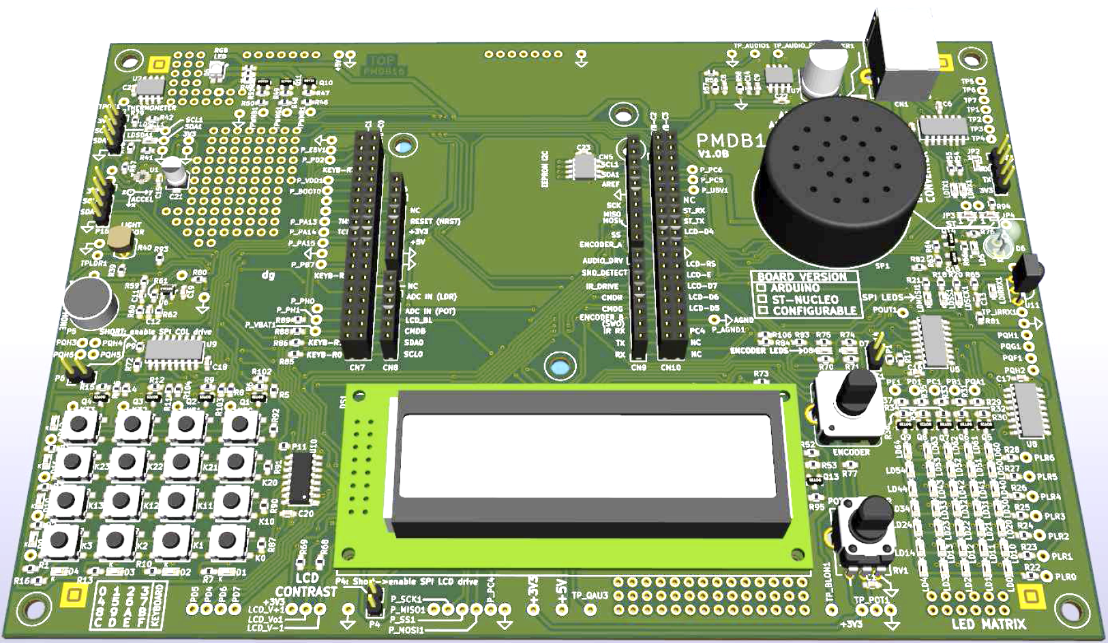
LCD – Evaluation Board Components Overview
LCD

Slide 3
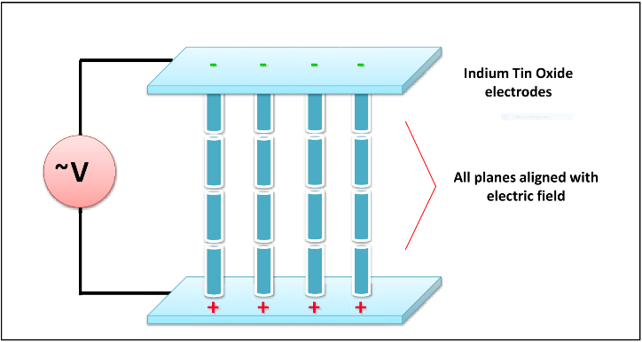
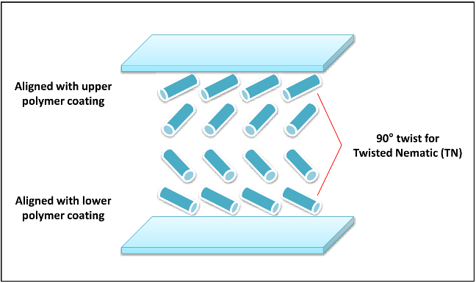
LCD technology
LCD: Liquid Crystal Display
Technology leveraging the nematic phase of liquid crystals
Liquid crystals in nematic phase flow as a liquid but have the same optical properties as those of crystals
They can be easily oriented by applying electric/magnetic fields
A segment of an LCD is considered ON when enough electric potential is applied between the segments and common electrodes
A segment of an LCD is considered OFF when insufficient electric potential is applied between the segment and common electrodes
ON
OFF

Slide 4
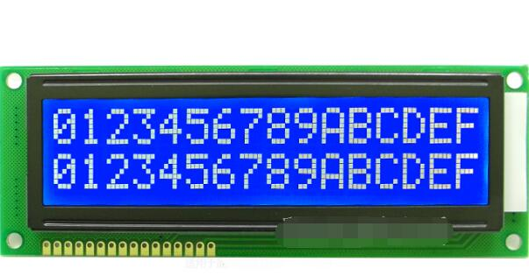
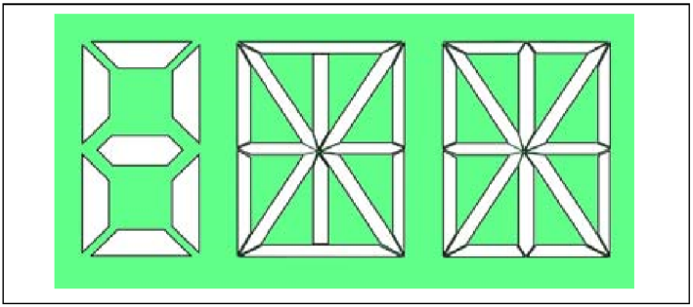
LCDs classification
Segment Displays
Dot Matrix
Usually 7, 14 or 16 segments used to create numbers and letters
Good contrast and readability in sunlight
Typical application of segment displays are in calculators, digital clocks and other applications that don’t require an high resolution
Always multiplex type display, because of the large number of pixel required → pin limitations use a driver.
Can create more detailed letters and numbers, as well as custom graphic symbols
Our POLIMI expansion board embeds a 16x2, 5x8 dot matrix LCD display

Slide 5
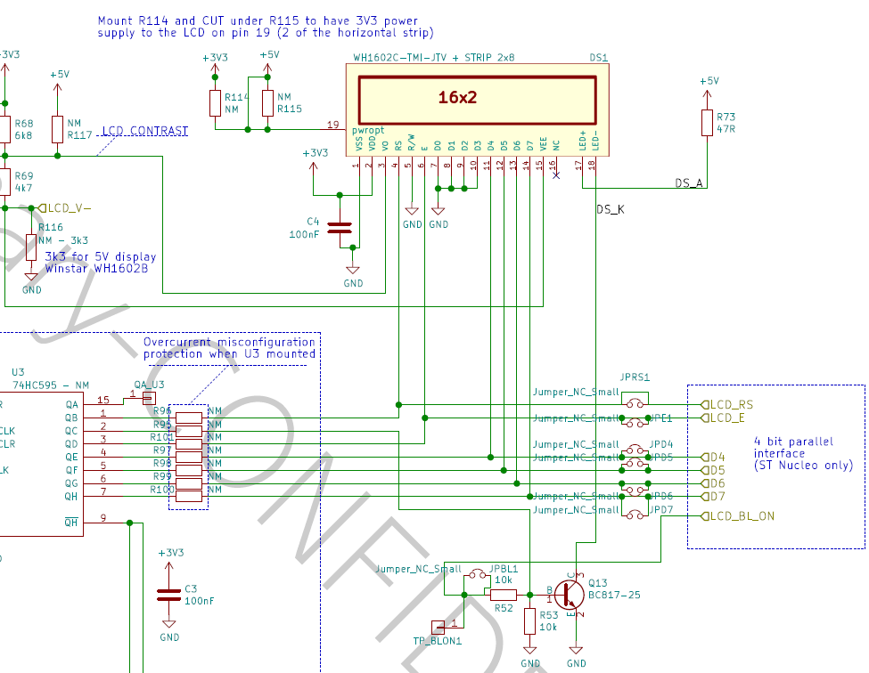
Step 1
Let’s open the datasheet of the expansion board
Interface between LCD and NUCLEO:
LCD_RS
LCD_E
D4
D5
D6
D7
LCD_BL_ON
Let’s identify their purpose

Slide 6
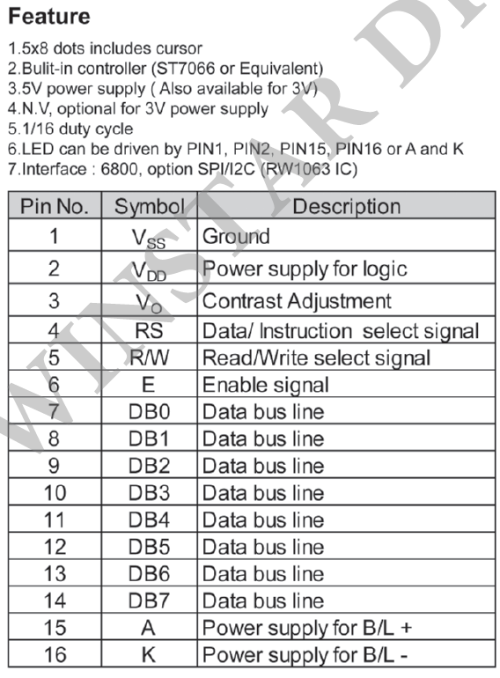
Step 2
Let’s open the datasheet of the LCD module (Winstar WH1602C)
What we can find is:
The controller IC: Sitronix ST7066
What the lines are:
Control lines (RS, R/W, E)
Data lines (DB4 – 7)
Backlight LED (L+, L-)

Slide 7
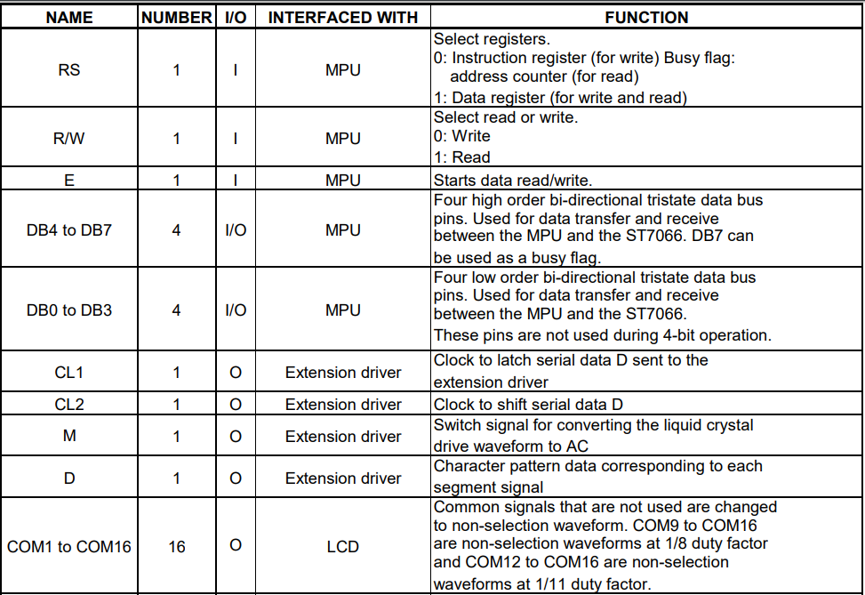
Step 3
Let’s open the controller datasheet

Slide 8
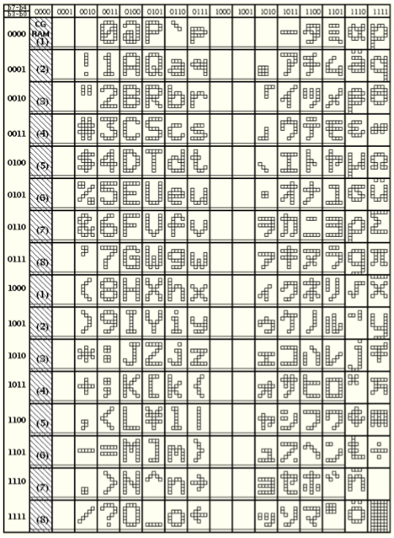
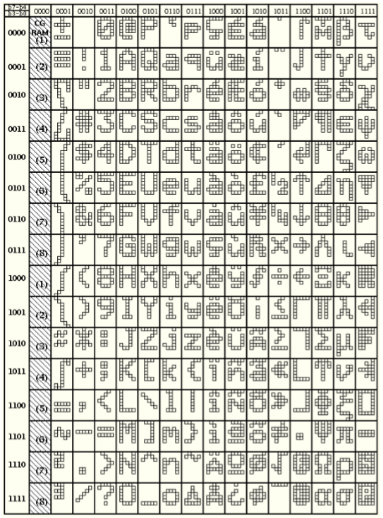
Step 3: Main internal registers - 1
CGROM (Character Generator ROM):
contains the binary values required to display a preset of characters

Slide 9
Step 3: Main internal registers - 2
CGRAM (Character Generator RAM):
contains space for up to 8 custom characters 5x8 dot matrix that can be programmed (volatile memory, content is lost if power is disconnected)

Slide 10
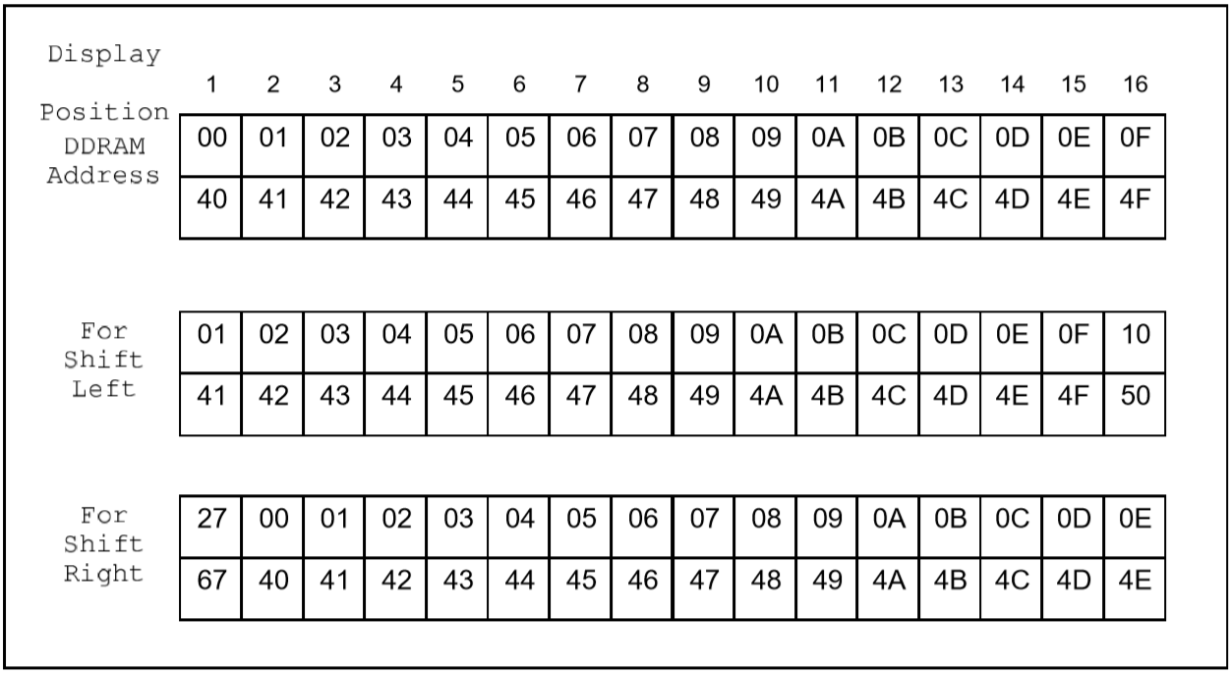
Step 3: Main internal registers - 3
DDRAM (Display RAM):
stores display data as 8-bit codes (address of the character in CGROM/RAM).

Slide 11
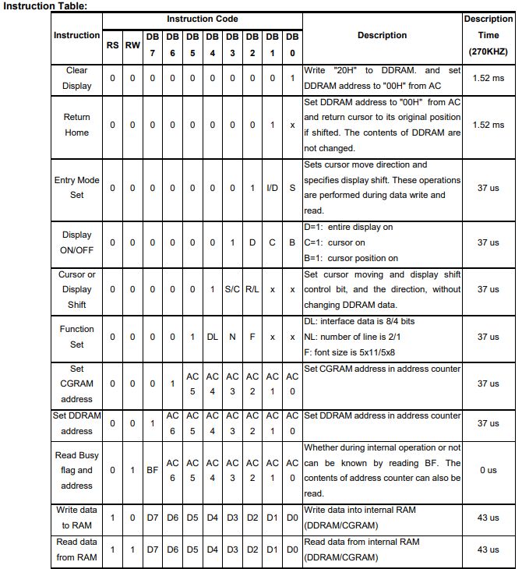
Step 4 – Instruction Table
To write a character
Set DDRAM address to the position where we want to draw it
To write a second character, if on the following position, just write the 8b data: address is auto-incremented.
Write 8b CGROM address of the selected character
CGROM address corresponds to the char ANSI code.

Slide 12
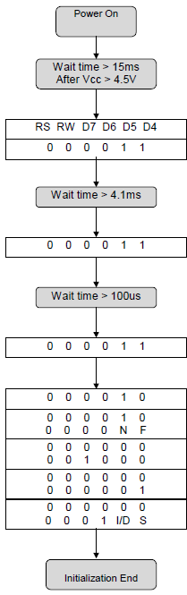
Step 5 – Initialization (4 bit mode) - 1
To write anything:
Set RS; RW; D7-4 values to the desired value
Give a pulse 0 →1→ 0 to the E line to latch the value in the controller (Page 23)
After initialization, to write a byte:
First write the most significative nibble (00110001)
Then the least significative nibble (00110001)

Slide 13
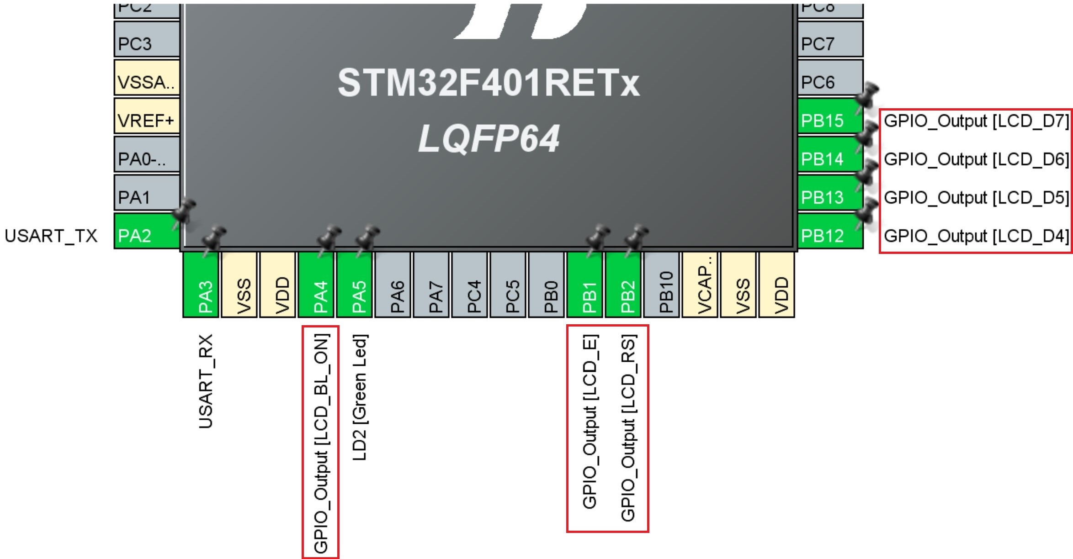
Pinout Configuration
Notes:
13

Slide 14
LCD library
To use the LCD:
Configure the required GPIO pins (see previous slide) as outputs
Import the “PMDB16_LCD” library in your STM32cubeIDE project:
Copy the “PMDB16_LCD.c” file to your project/Core/Src folder
Copy the “PMDB16_LCD.h” file to your project/Core/Inc folder
Add #include "PMDB16_LCD.h“ in your main.c
Initialize the LCD controller before the while (1) loop.
Write to the LCD with the provided functions.
See next slide for an overview of the functions.
Notes:
14

Slide 15
LCD library high level functions
void lcd_initialize(); Initializes the LCD controller.
void lcd_backlight_ON(); Turns ON(OFF) the LCD backlight.
void lcd_backlight_OFF();
void lcd_println(char string[], uint8_t row);
Prints the string on the top (0) or bottom (1) row of the LCD.
Maximum string length = 16 characters.
void lcd_drawBar(int value);
Prints a bargraph on the bottom row of the LCD controller. Value range: 0 to 80.
Each increment corresponds to enabling one extra column of the dot matrix display.
void lcd_clear();
Clears the entire display.
Notes:
15

